Slide 1
Regional and social variation of Finnish prosody
- Data collecting via crowdsourcing
Tommi Kurki
University of Turku
Hamid Behravan
University of Turku &
University of Eastern Finland
Tommi Nieminen
University of Eastern Finland
Heini Kallio
University of Helsinki

Slide 2
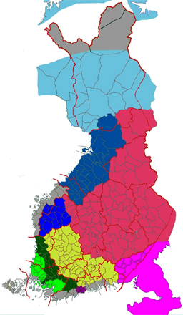
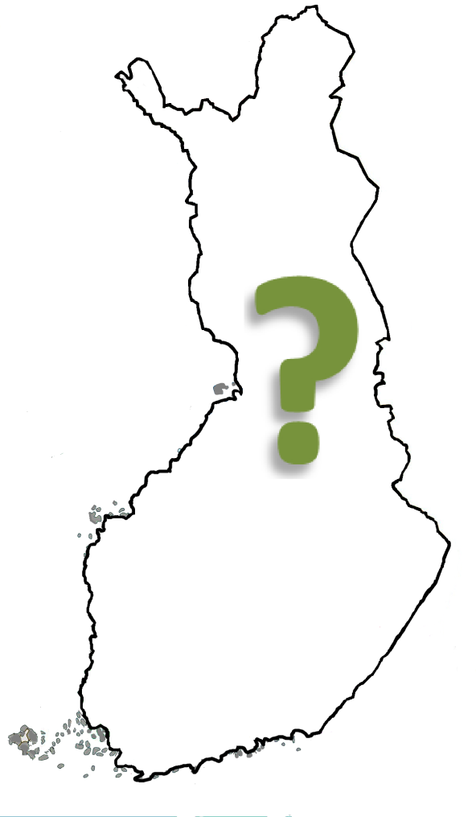
Regional and social variation of Finnish prosody

Slide 3
Regional and social variation of Finnish prosody
Funded by Kone Foundation
Project started in August 2013
Lead researcher: lecturer, docent Tommi Kurki (UTU)
Postdoc researcher, university lecturer Tommi Nieminen (UEF)
Project researcher Hamid Behravan (UTU, UEF) started in November 2013
PhD student Heini Kallio (UH) started in January 2014

Slide 4
Regional and social variation of Finnish prosody - GOALS
To study the (regional & social) variation of spoken Finnish prosody
To collect a speech corpus suitable for mentioned research purposes
To develop and use new methods for collecting speech data (crowdsourcing)
To meddle with sociolinguistics, phonetics and computer science

Slide 5
Why?
There’s relatively little studies on the prosody variation of spoken Finnish
Most prosody studies are based on read speech or standard spoken language
When prosody variation is studied, it’s often focused on functional and communicational variation instead of regional or social variation
Most studies on Finnish language variation are from a linguistic point of view
There’s no speech corpus designed especially for studying prosody variation in Finnish

Slide 6
Why prosody?
Prosodic features are shown to have a significant role in many aspects of communication, e.g.
Speech intelligibility
Expression and identification of emotions
Language identification
Semantics & grammatics
Conversational flow (e.g. turntaking and -giving)
Information about Finnish prosody variation is applicable to e.g. second language teaching, speaker and speech recognition applications and speech synthesis applications

Slide 7
Goal 1: mapping Finnish prosody
Regional variation is rather well known in segmental and morphological level, but not in the prosodic level of speech
Studies have focused mainly on standard spoken Finnish/some specific dialect
There’s plenty of anecdotal information about regional variation (e.g. imitating), but not much explicit research

Slide 8
Goal 2: collecting the speech corpus
Existing Finnish speech corpora:
MediaTeam emotional speech database (14 informants, 490 utterances)
PERSO database for Finnish speech synthesis (66 informants, 43 000 utterances)
FinINTAS corpus of spontaneous and read-aloud Finnish (20 informants, 10 hrs)
Kotus: Samples of Spoken Finnish from 50 towns/districts (100 informants, 100 hrs of interviews)
Etc.

Slide 9
Goal 2: collecting the speech corpus
Why we need another speech corpus?
There’s no corpus designed and collected especially for studying prosody variation
Either the collected speech corpuses consist of read speech and standard spoken language or they are focused on one dialect area
Number of informants/area is often small
-> can lead to corrupted generalizations of dialect in question

Slide 10
Goal 3: developing collecting methods
Attempt to use crowdsourcing
in data collecting
Crowd + outsourcing
= crowdsourcing
Obtaining content from
large groups, usually from
an online community
Spoken language changes fast; via crowdsourcing it’s possible to reach larger groups and collect a more inclusive and up-to-date database
http://nachoocejo.blogspot.fi

Slide 11
Goal 3: developing collecting methods
Crowdsourcing has not been applied to collecting speech data (as far as it’s known), so questions are followed:
How to ensure the quality of the speech data?
How to make the website tempting enough?
How to make the website visible enough for public?
How to avoid trolls?
Will the quality of the recordings still be good enough for research purposes?

Slide 12
Goal 3: developing collecting methods
A website is created for testing this method:
https://puhu.utu.fi/
Project information pages are open to public
To access the actual recording tasks, registering is required
The registered user can record their own voice and listen to samples chosen by the research group
User can also rate speech samples according to which dialect area they think the samples represent and how well (listening tests in closed network)

Slide 13
Evaluation methods
The current recording tasks include:
Microphone testing (enumerating from 1 to 10, listing weekdays & months)
Short sentences written in standard language & request to tell what user did that morning
A dialogue set with pre-recorded prompts
A picture difference task
Written dialectal alternatives
Another dialogue set with pre-recorded prompts

Slide 14
Evaluation methods

Slide 15
Evaluation methods

Slide 16
Evaluation methods
Our purpose is to elicit different speech styles, both read and (semi-)spontaneous speech, and to see which tasks lead best to dialectal speech

Slide 17
At first speech data will also be collected using traditional methods -

Slide 18
Prosody in spoken language
Prosodic features affect e.g. speech intelligibility, perception and language learning
There’s language specific prosodic features that can be used for identifying languages without any lexical information (e.g. Ohala & Gilbert, 1981)
Language-specific intonation, rhythm and stress are important cues when separating and identifying speech chunks (e.g. Aho, 2010)

Slide 19
Prosody in spoken language
Regarding regional variation in Finnish prosody, studies have focused mainly on phoneme length (e.g. allophonic half-long and extra-long vowels, geminate) *reference!
Is there in-language variation in more prevalent features, like intonation and stress patterns?
Could there be dialect-specific features, that are recognizable through speech prosody?
How could this be studied?

Slide 20
Delexicalization as a prosody research tool
Listeners use lexical and grammatical information in decoding prosody related phenomena in speech utterances
Delexicalization aims to produce a signal in which lexical or segmental information has been removed, but prosodic features remain
Method is used in studying the effects or perception of prosodic features, e.g. language identification or prominence perception

Slide 21
Delexicalization as a prosody research tool
Earlier studies have used e.g. low pass filtered speech and different signal generator techniques, where the F0 and amplitude have been extracted from original speech sounds and added to a synthesized ”buzz” (see e.g. Ohala & Gilbert, 1981)
These generated signals might be hard to associate to natural speech

Slide 22
Delexicalization as a prosody research tool
A new method is based on glottal excited parametric speech synthesis scheme (Vainio et al., 2009)
Uses glottal inverse filtering to decompose the speech signal into voice source and the vocal tract filter
Both features are reconstructed from parameters
The parameters of the varying vocal tract filter are replaced with with ones representing a neutral vowel
Enables the manipulation of all relevant prosodic features (inc. voice quality)

Slide 23
Delexicalization as a prosody research tool
Original speech sample
Delexicalized speech sample

Slide 24
One research plan in a nutshell…
Can dialects be distinguished/identified by their prosody only?
If so, what are the distinguishing features?
2AFC listening tests with original and delexicalized speech samples
The task is to decide whether the samples are of same or different dialect

Slide 25
One research plan in a nutshell…

Slide 27
“Never express yourself more clearly than you are able to think.”
- Niels Bohr.

Slide 28
References
E. Aho, Spontaanin puheen prosodinen jaksottelu. Doctoral dissertation, Department of Modern Languages, University of Helsinki, 2010.
M. Vainio, A. Suni, T. Raitio, J. Nurminen, J. Järvikivi & P. Alku, New Method for Delexicalization and its Application to Prosodic Tagging for Text-to-Speech Synthesis. In Proceedings of Interspeech, Brighton, 2009.
J.J. Ohala & J.B. Gilbert, Listeners’ ability to identify languages by their prosody. In P. León & M. rossi (eds.) Problêmes de Prosodie, volume 18, pages 123-131. Studia Phonetica, 1979.
G. Sonntag & T. Portele, PURR – A method for prosody evaluation and investigation. Computer, Speech and Language, 12(4): 437-451, 1998.
M. Barkat, J. Ohala & F. Pellegrino, Prosody as a Distinctive Feature for the Discrimination of Arabic Dialects. In Proceedings of Eurospeech, Budapest, 1999.
A. Kain & J. van Santen, Frequency-Domain Delexicalization using Surrogate Vowels. In Proceedings of Interspeech, Chiba, Japan.
R. Ogden & S. Routarinne, The communicative function of final rises in Finnish intonation. Phonetica 62: 160-175, 2005.

